Slide 1
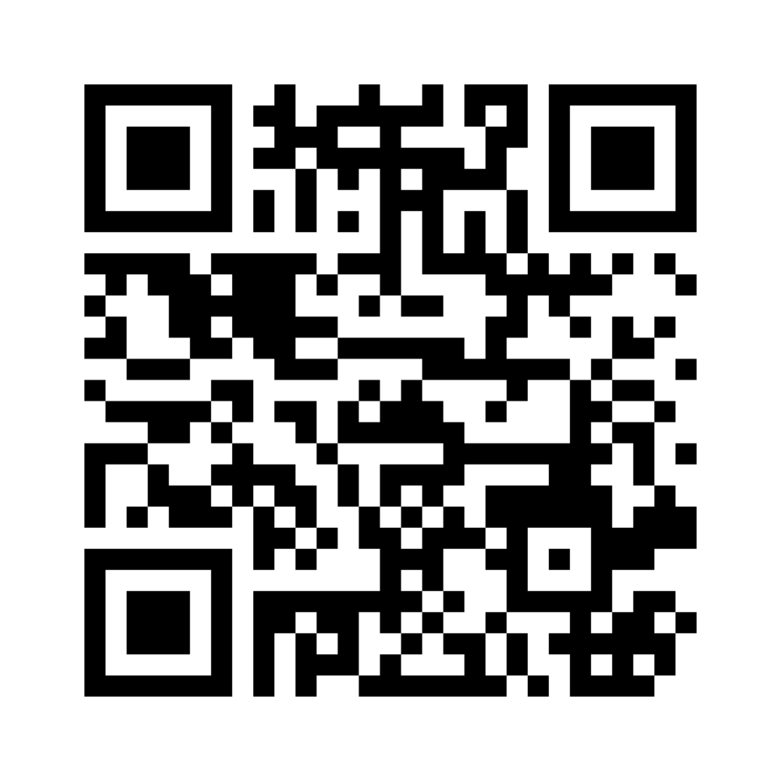
ChatGPT
Introduction
Scan this image with your phone’s camera to open a link to our survey.
June 21, 2023
San Gabriel Valley City Managers’ Association

Slide 2
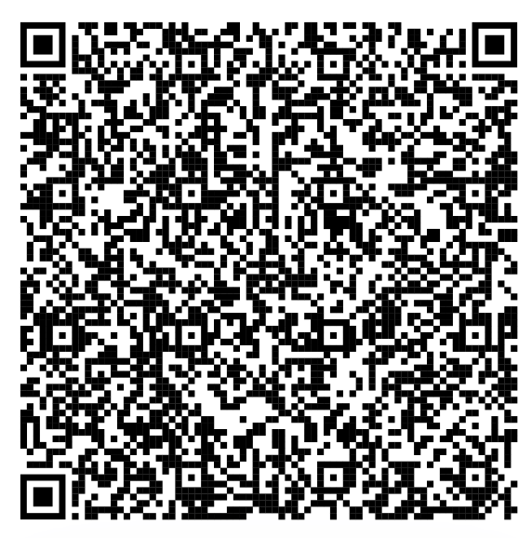
Welcome
City of Glendale
Innovation Project Manager
Greg Kajszo
Introduction to ChatGPT

Slide 3
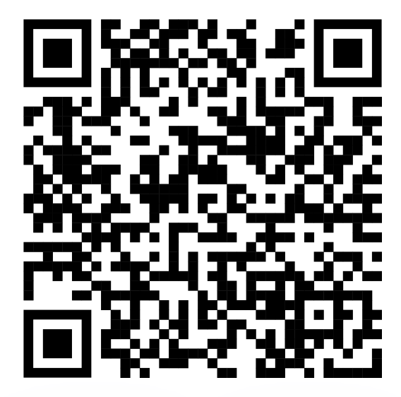
Welcome
City of Glendale
Chief Innovation Officer
Elena Bolbolian
https://linkedin.com/in/ebolbolian
ChatGPT Introduction

Slide 4
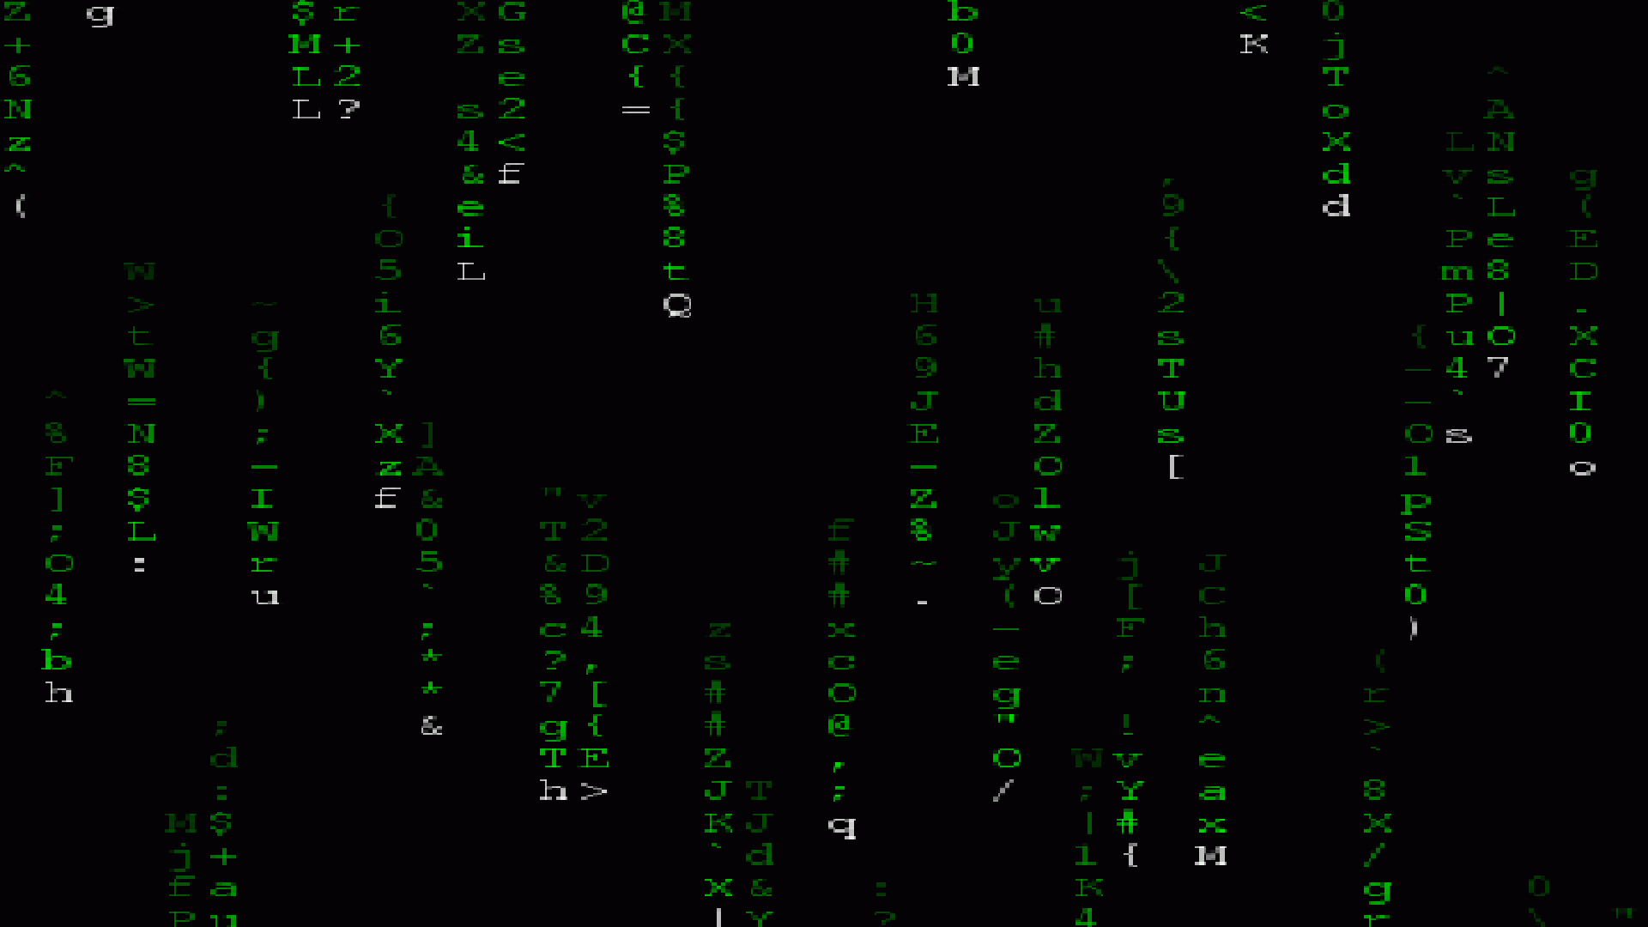
Intro to ChatGPT
Notes:
how many people have heard of ChatGPT? (hands)
How many people have used it themselves? (hands)

Slide 5
Intro to ChatGPT
A language model trained to learn patterns in human text.
ChatGPT Introduction
Notes:
ChatGPT is a language model developed by OpenAI. It is based on the GPT (Generative Pre-trained Transformer) architecture, specifically GPT-3.5. ChatGPT is designed to generate human-like responses to text inputs and engage in conversation with users.
The model is pre-trained on a vast amount of text data from the internet, allowing it to learn patterns, grammar, and contextual relationships. It can understand and generate text in multiple languages and has a wide range of applications, including chatbots, language translation, content generation, and more.
ChatGPT uses a transformer neural network architecture, which is known for its ability to capture long-range dependencies in text and generate coherent and contextually relevant responses. It leverages the power of deep learning and large-scale data to provide increasingly accurate and natural language interactions.

Slide 6
Intro to ChatGPT
Practice Prompts
ChatGPT Introduction
Notes:
poem about the convening
email invitation to the convening

Slide 7
What ChatGPT Can Do Very Well
ChatGPT Introduction
Notes:
understand written language
organizing, synthesizing, responsive (converse with it)
writing (any style of writing - technically, simple, funny, poetic - long, short)
(consider: summariinzg transcripts of council meetings?)

Slide 8
GPT @ City Hall
ChatGPT Use Cases @ City Hall
Ordinance to Ban Single-Use Plastics
Professional Apology Email for A Service Request Delay
Identify GHG Emission Opportunities
ChatGPT Introduction
Notes:
Create an ordinance for the city of Glendale CA that bans the use of single-use plastic bags by businesses. the ban should include a 6-month transition time before enforcement begins. medical devices are exempt.
You are a representative from the office of the city manager in Glendale, California. Compose a formal email apologizing to a resident about a recent delay in a bulky item pickup that they requested. Do not propose why the delay happened.
What are some of the biggest opportunities in Glendale CA for GHG emission reductions given the inventory and primary strategies, both municipal and community

Slide 9
Pitfalls of ChatGPT
ChatGPT Introduction
Notes:
Microsoft already flagging GPT-written emails
“data” provided isn’t always accurate
Lawyer referencing a fake legal case
(same can happen to presentations to city council)
Language is predominantly english
Ethics
Large risk of plagiarism (also AI plagiarism)
Security
Data is vulnerable
GPT being used to improve cyberattacks (it can code)

Slide 10
GPT @ City Hall
Adoption in Local Governments
ChatGPT Introduction
Notes:
innovation testing it and advocating for GUIDELINES citywide
other cities that have policies: what are they. (Boston = everyone can use it; State example = cannot use it. banned on phones)

Slide 11
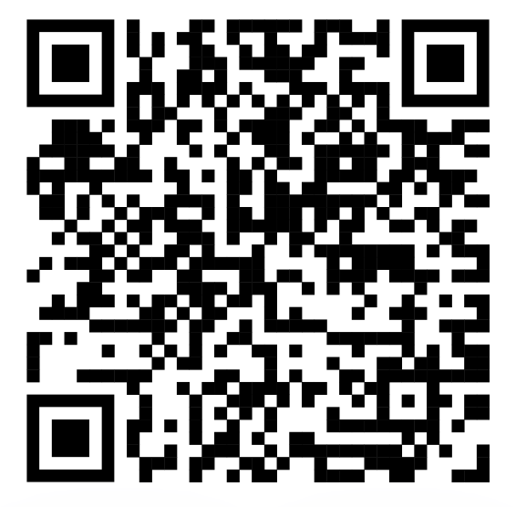
Closing
See you next time
https://linktr.ee/glendaleinnovation
ChatGPT Introduction
Notes:
GK Intro
Thanks for coming
We will email a survey that will help give us feedback and improve these events in the future
If you’re interested in hosting talk to Amanda
Happy hour is right across the street at Oak and Vine (upstairs!)

