Slide 1
Delivering a World-Class Customer Experience
Lessons From the Mouse
Presented to
San Gabriel Valley City Managers’ Association
by Danny Snow

Slide 2
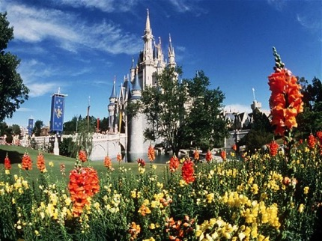
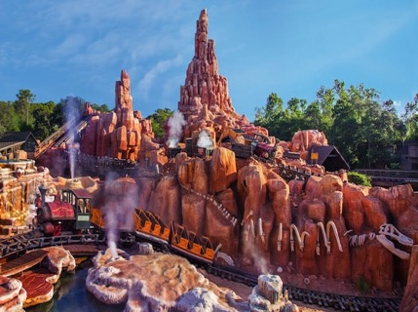

Slide 3
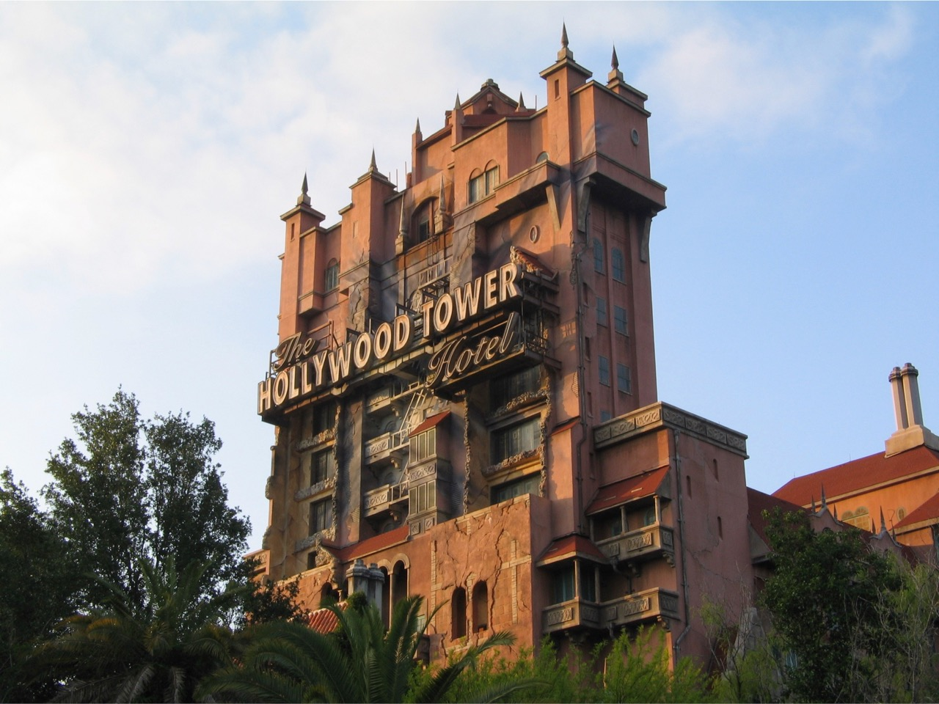

Slide 4
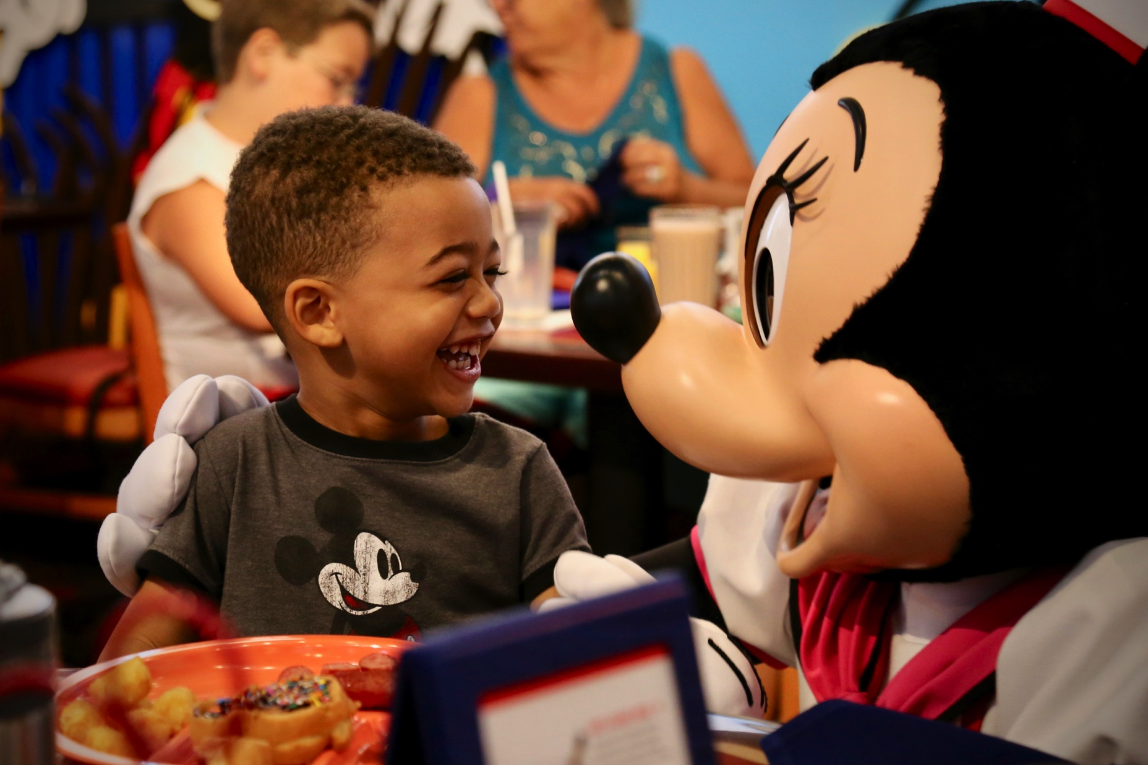
1
Look At Everything Through the Lens of the Customer

Slide 5
Customer Experience Mapping

Slide 6
Customer Experience Mapping
The customer…
The customer…
The customer…
The customer…
The customer…
The customer…
The customer…
The customer…
The customer…

Slide 7
Block # | Mediocre Service | Excellent Service

Slide 8
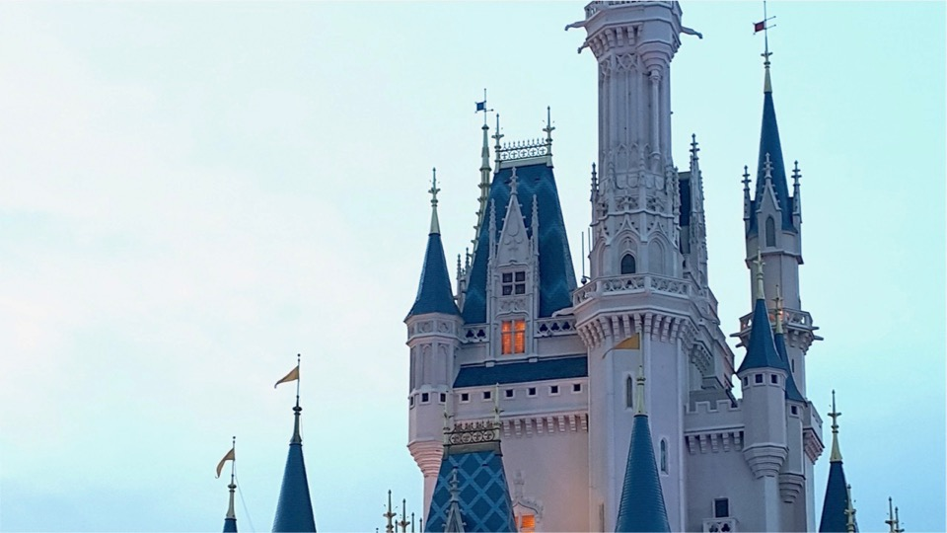
Example: Hotel Return
Ride bus
to hotel
Enter
lobby
Ride
elevator
Ride
elevator
Enter
room
Walk to
room

Slide 10
Example: Hotel Return
Ride bus
to hotel
Enter
lobby
Ride
elevator
Ride
elevator
Enter
room
Walk to
room

Slide 11
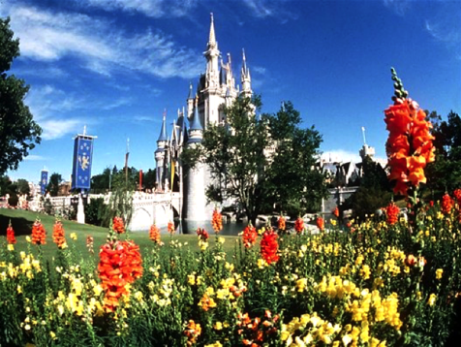
2
Pay Attention to the Details:
Everything Speaks

Slide 12
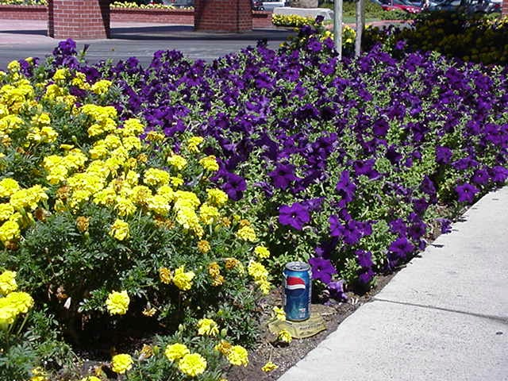

Slide 13
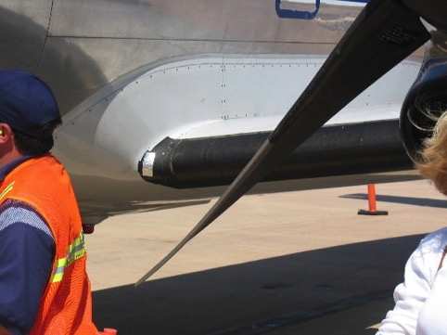
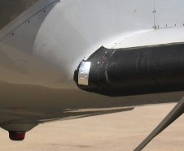

Slide 14
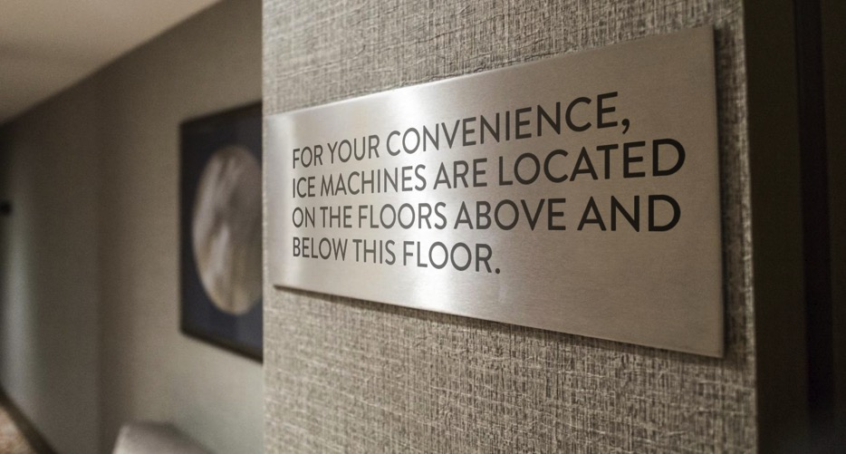

Slide 15
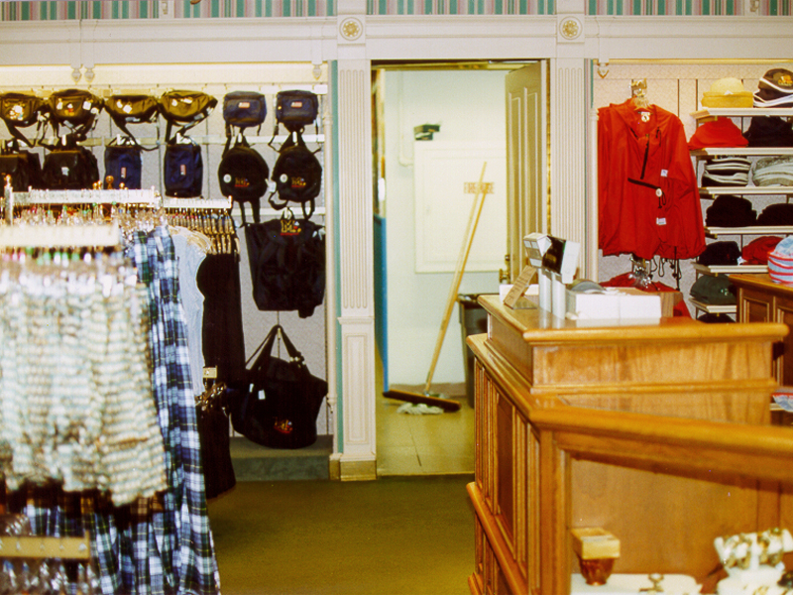

Slide 16
“Attitudinal”Everything Speaks

Slide 17
Everything Speaks
Everything Speaks
Distracter
Everything Speaks
Commitment

Slide 18
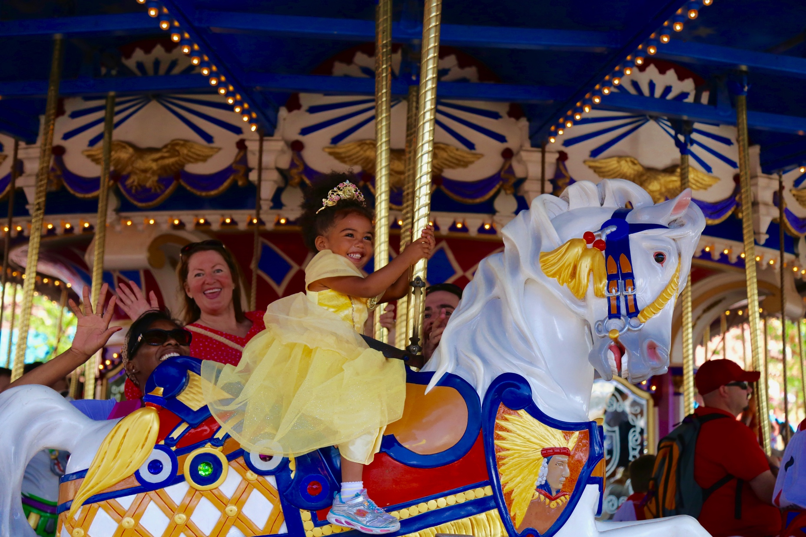
3
Create
Moments of Wow

Slide 19
Customer Expectations
Advice
Partnership
Availability
Accuracy
Wow Opportunities
Dissatisfiers

Slide 20
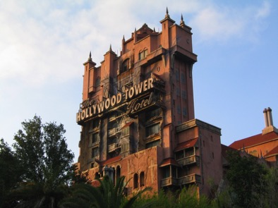
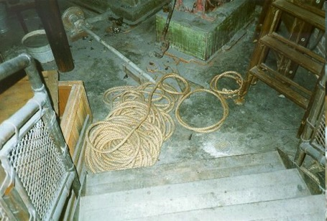
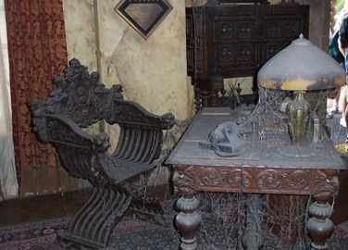
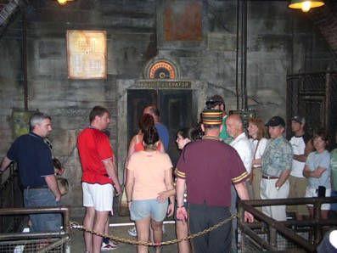

Slide 21
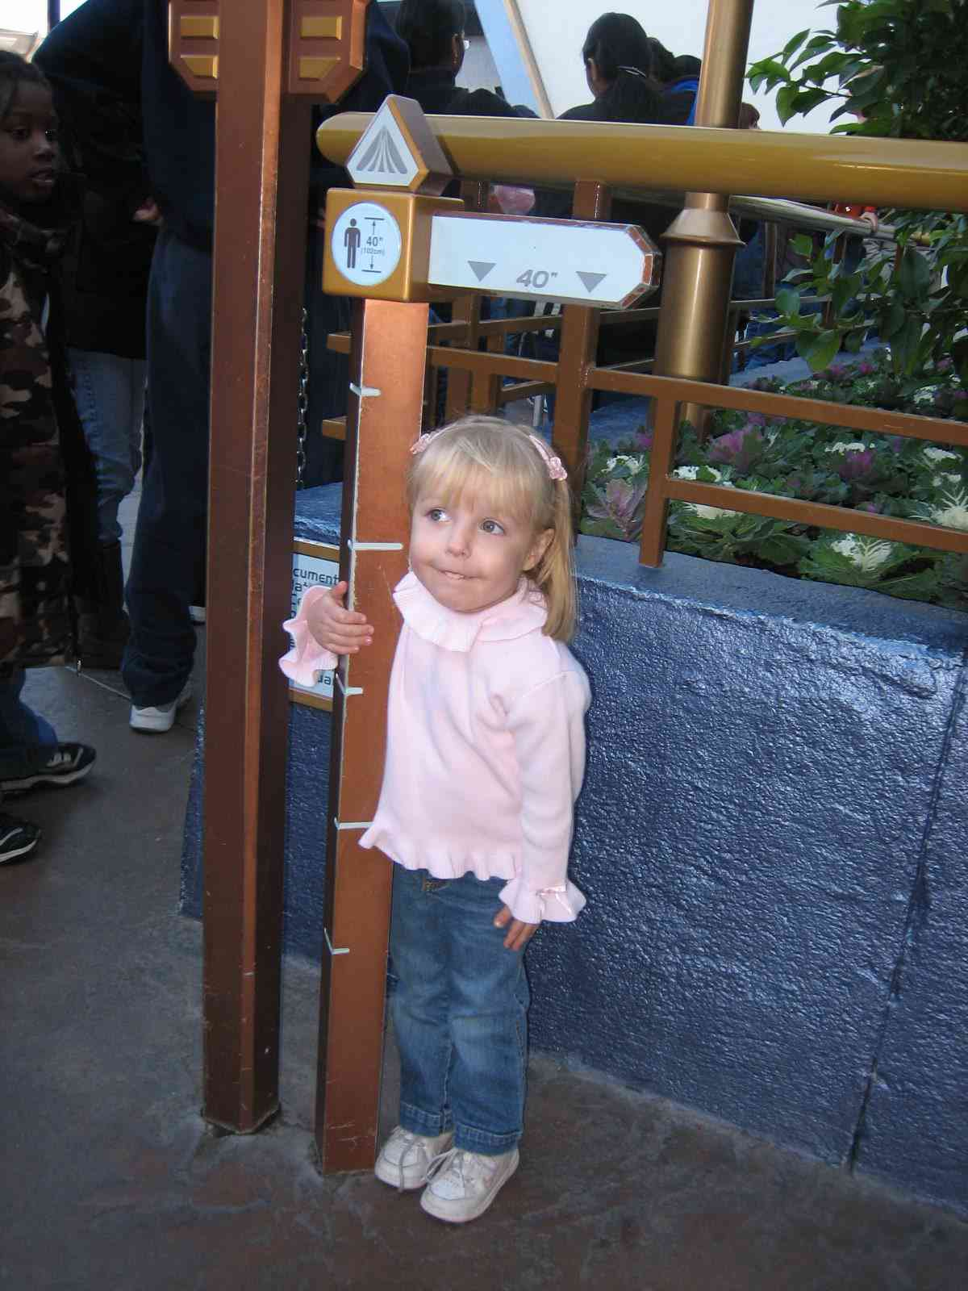
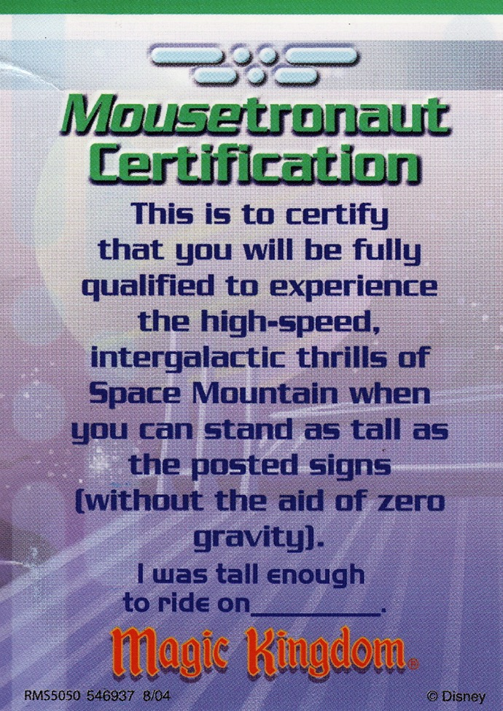

Slide 22
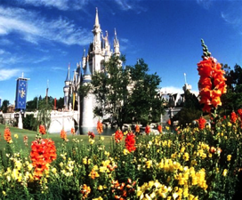
1
2
3
Lens of the Customer
Everything
Speaks
Moments of Wow

Slide 23
Customer Loyalty

Slide 25
Delivering a World-Class Customer Experience
Lessons From the Mouse
Presented to
San Gabriel Valley City Managers’ Association
by Danny Snow

