Slide 1
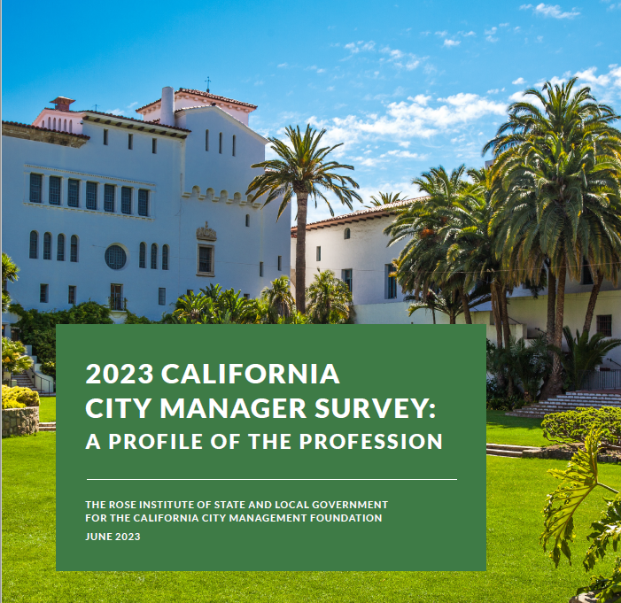
Prepared and presented by:
JUNE 2023

Slide 2
INTRODUCTION

Slide 3
SURVEY METHODOLOGY

Slide 4
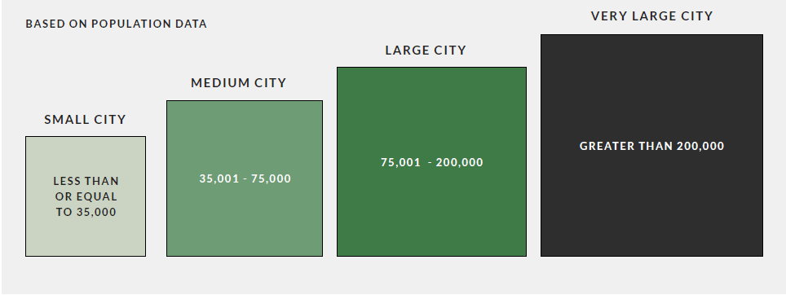
City Size Categories

Slide 5
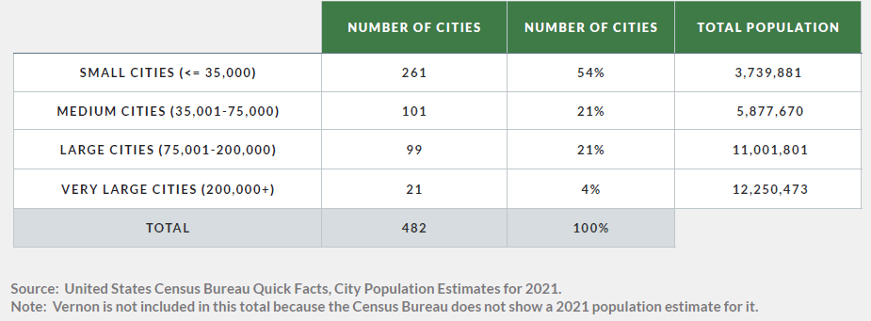
City Size by Category

Slide 6
DEMOGRAPHIC PROFILE

Slide 7
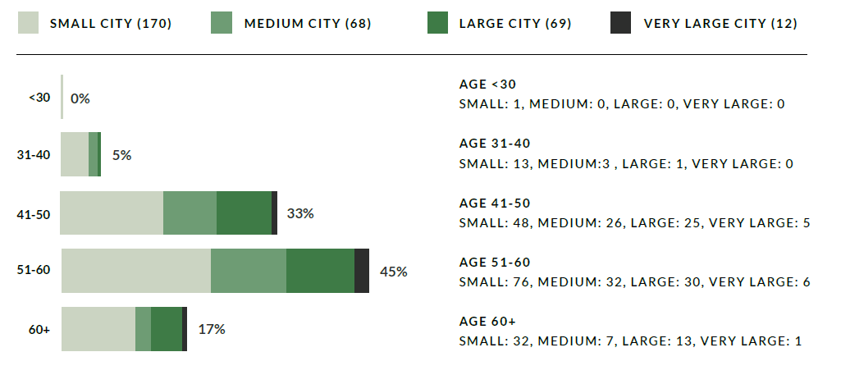
Age and City Size
Q. What is your age? N=319
Note: City size based on 2021 population estimates from United States Census Bureau.

Slide 8
Gender

Slide 9
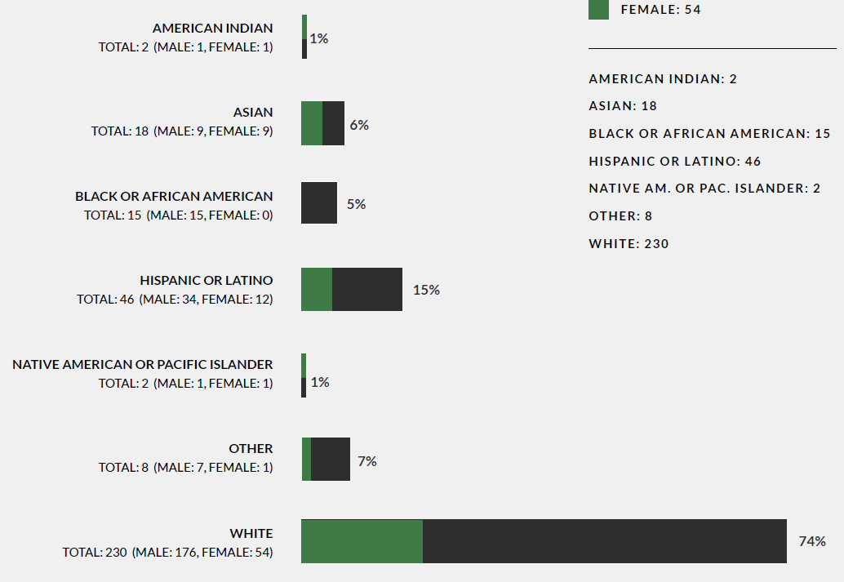
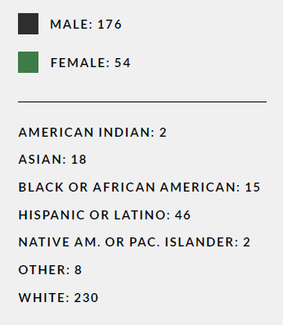
Race and Ethnicity and Gender
Q. What is your gender? Q: Based on these U.S. census Bureau categories, with what race and ethnicity do you most identify yourself? (Check all that apply.) N=312.

Slide 10
Education
Q: What is the highest degree or level of school you have completed? N=431.
Note: 318 responded to this question on the survey. The remaining 113 are taken from publicly available sources such as city websites, newspaper articles, and LinkedIn.

Slide 11
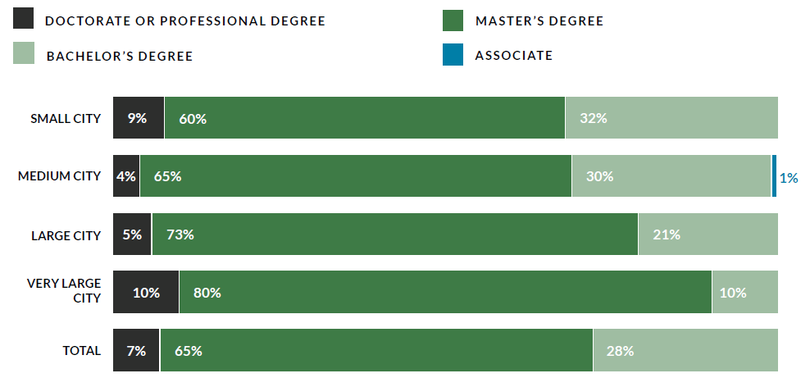
Education and City Size
Q: Major subject studied? N=425.
Note: 312 responded to this question on the survey. The remaining 113 are taken from publicly
available sources such as city websites, newspaper articles, and LinkedIn.

Slide 12
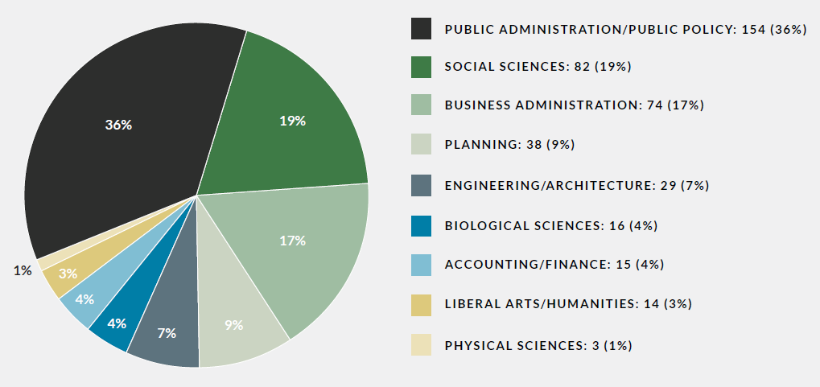
Major Subject Studied
Q: Major subject studied? N=425.
Note: 312 responded to this question on the survey. The remaining 113 are taken from publicly available sources such as city websites, newspaper articles, and LinkedIn.

Slide 13
California Native

Slide 14
EMPLOYMENT PROFILE

Slide 15
Local Government Career Start in California

Slide 16
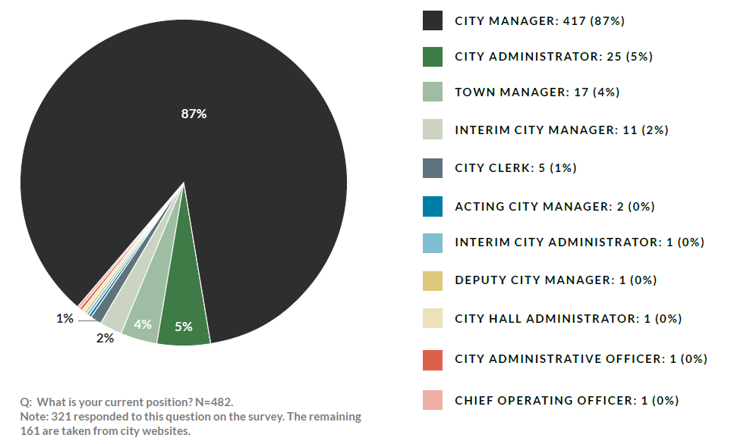
Current Position
Q: What is your current position? N=482.
Note: 321 responded to this question on the survey. The remaining 161 are taken from city websites.

Slide 17
Time in Current Position

Slide 18
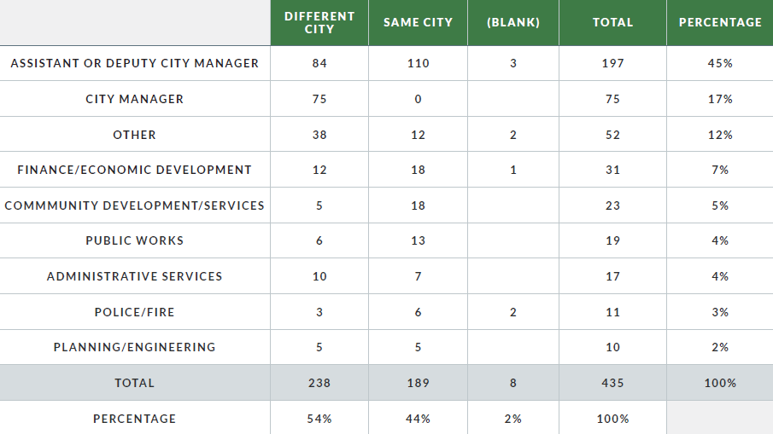
Prior Position and Same or Different City
Q: What was your position prior to becoming a city manager? N=435.

Slide 19
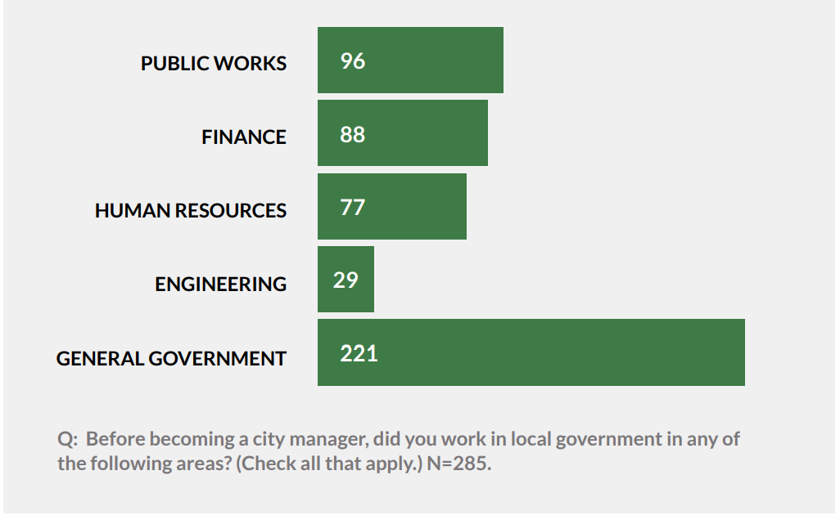
Prior Local Government Experience

Slide 20
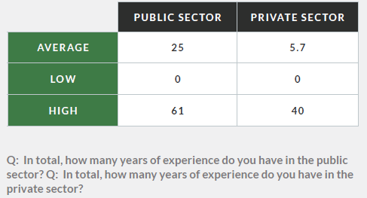
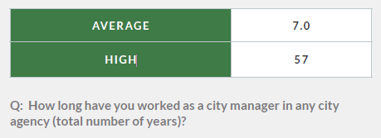
Total Years…
as a City Manager in
Any City Agency
in Public Sector
and Private Sector

Slide 21
CITY PROFILE

Slide 22
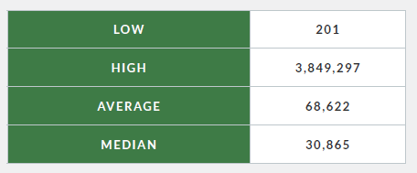
City Population
Source: United States Census Bureau Quick Facts, City Population Estimates for 2021.

Slide 23
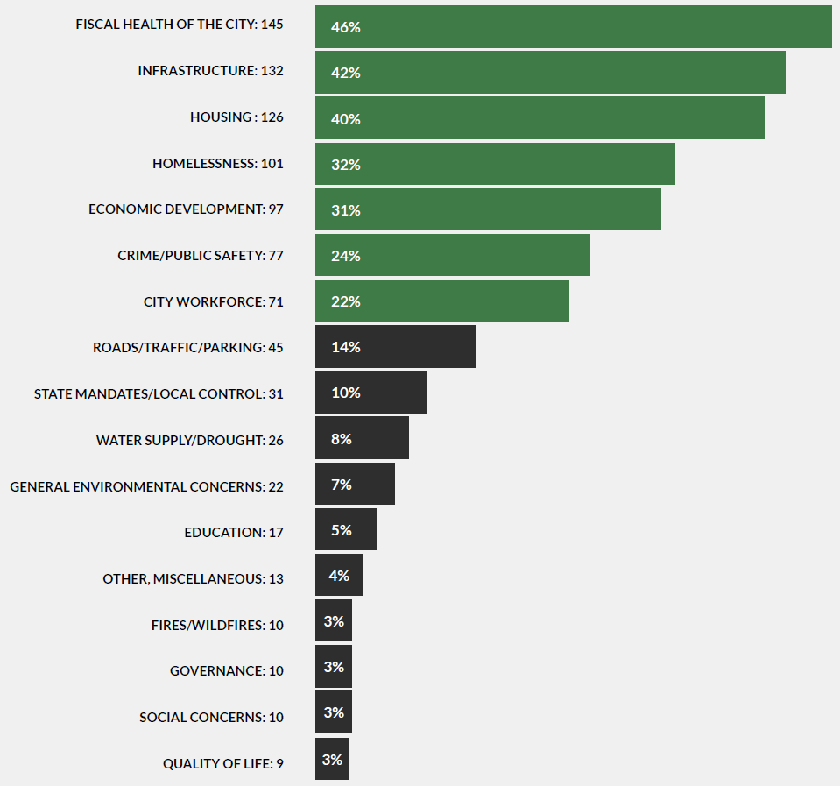
Most Pressing Issues
Q: What are the three most pressing issues for your city?
Note: 318 cities responded to this question. Each respondent could enter three issues. The percentages are calculated using 318 as the dominator.

Slide 24
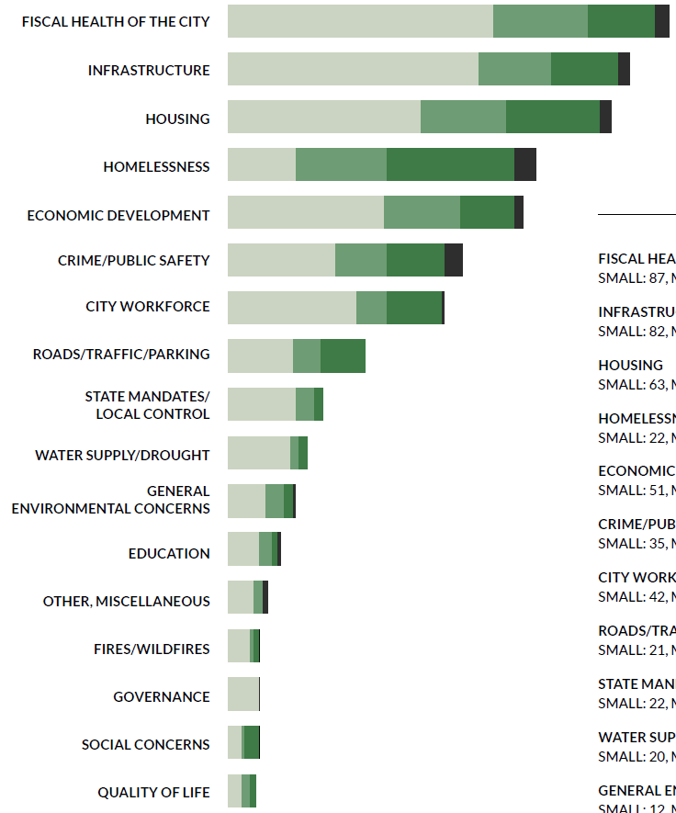
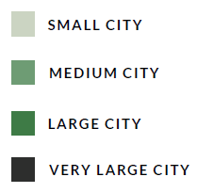
Most Pressing Issues and City Size
Q: What are the three most pressing issues for your city?
Note: 318 cities responded to this question. Each respondent could enter three issues.
Note: City size based on 2021 population estimate from United States Census Bureau

Slide 25
CONCLUSION

