Slide 1
Navigating the Stimulus Hangover
Focus on LA County
March 2023

Slide 2
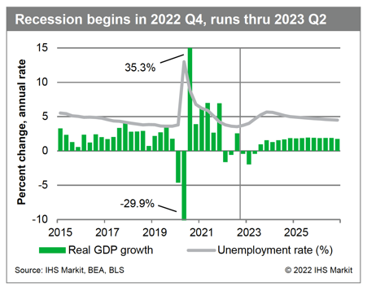
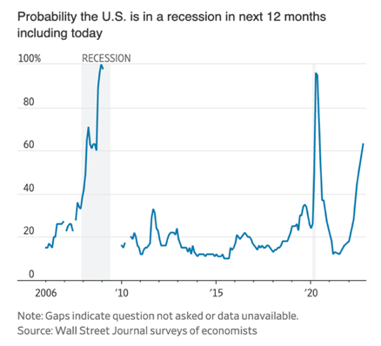
RECESSION!!!
Miserabilism:
the philosophy of pessimism.

Slide 3
Beware the Narrative!
“Trying to understand major economic events by looking only at data … runs the risk of missing the underlying motivations for change. Doing so is like trying to understand a religious awakening by looking at the cost of printing religious tracts.” ― Robert J. Shiller, Narrative Economics: How Stories Go Viral and Drive Major Economic Events

Slide 4
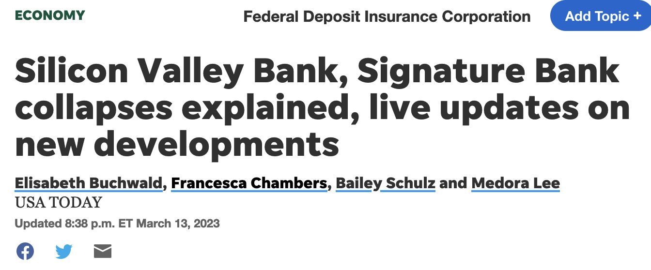
Mixed Economic Signals to start 2023

Slide 5
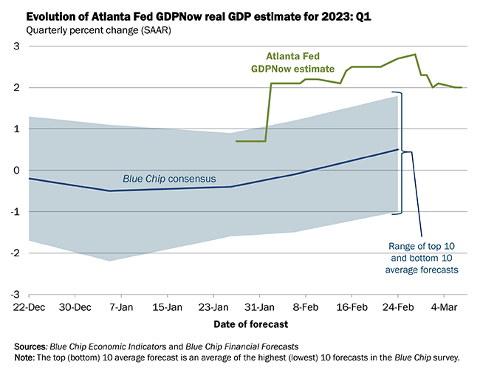
The US is clearly not in a recession now
Jan 23: 3.4%

Slide 6
So where are we heading?
The Narrative: A recession is nigh!
Economy already in crisis due to … (pick your favorite boogie man)
Inflation is hurting consumers
Real Estate collapse driven by mortgage rate hikes
The banking failures are a sign of the rot
The Reality: Recession highly unlikely in the next 2 years
Inflation / rising rates are the consequences of excessive stimulus
No major structural imbalances in the economy
Consumers / business investment will offset weakness in real estate, finance
Asset prices, including homes, will continue to slowly deflate, yet fundamentals will remain just fine
Banking issues are caused by dramatic shifts in Fed policy, not bank lending practices
The Real Worries
Collapse in filtering will intensify housing shortages
Labor shortages are now endemic
Public deficit challenges at state and federal levels
The potential (and pointless) bank credit crisis
The ongoing gap between the narrative and the reality

Slide 7
Miserabilism in letters…

Slide 8
Federal Fiscal (Over)reaction
Actual Lost GDP: $1.2 Trillion
Fiscal Stimulus: $6 Trillion
Most rapid economic recovery ever

Slide 9
Federal Fiscal (Over)reaction
Powell $5T 20-21
Bernanke $3.5T 08-14

Slide 10
QE and Money: Now vs Then
1970’s inflation driver: M1 growth
Powell QE $5T 20-21
Bernanke QE $3.5T 08-14

Slide 11
QE and Money: Then vs Now
The Problem of Excess Money
Short run: Money illusion
Falling interest rates
Asset price bubbles form
Spending and investment binge ensues
Long run: The Hangover
SR: Inflation and rates rise
SR: Asset markets sag
LR: Sharp transfers of real wealth
LR: Investments risk rises

Slide 12
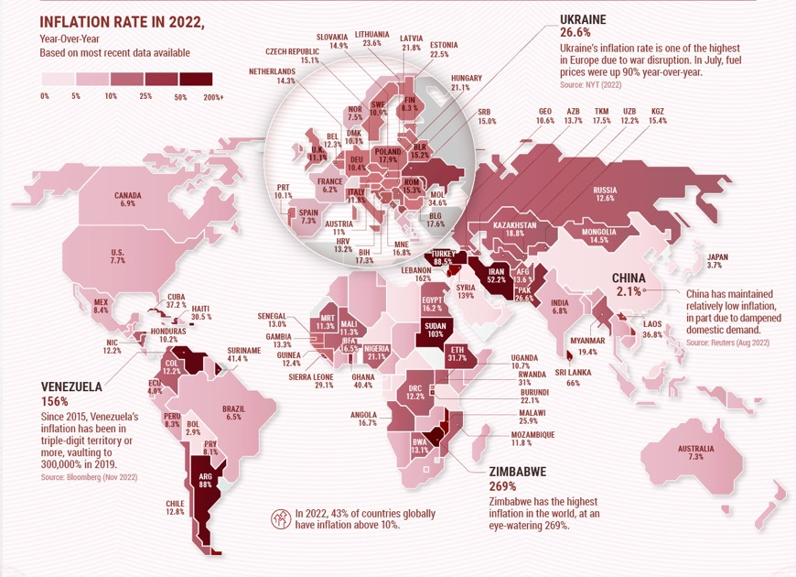
Inflation nation…

Slide 13
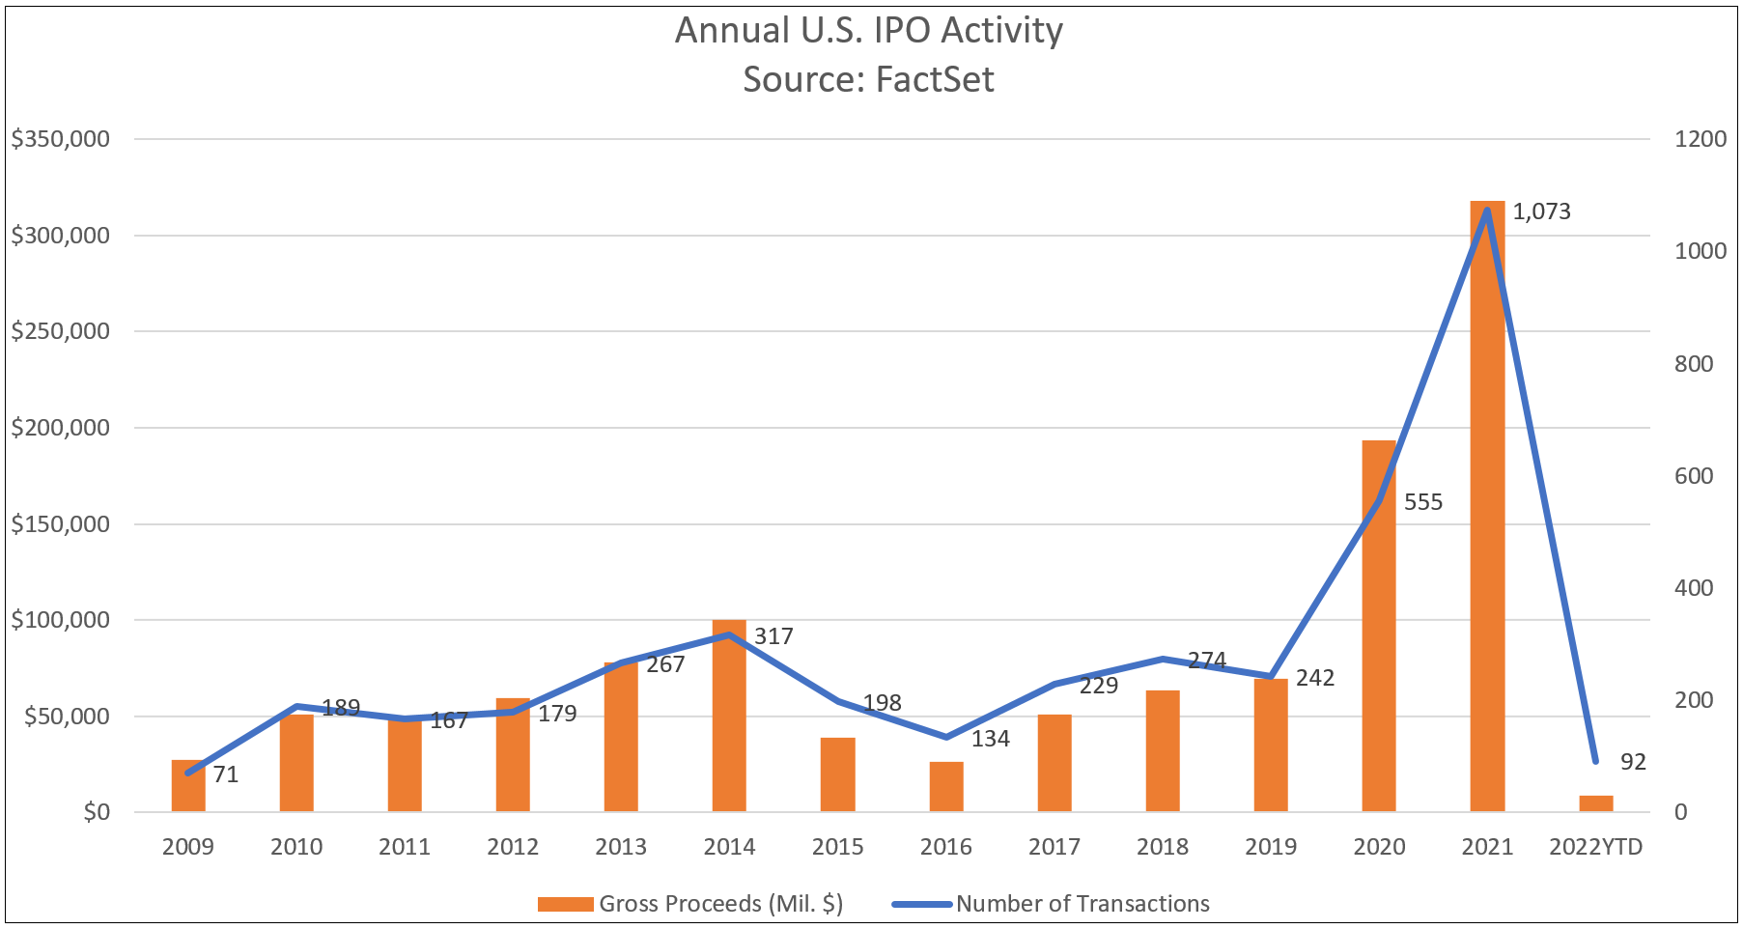
Gravity still works…

Slide 14
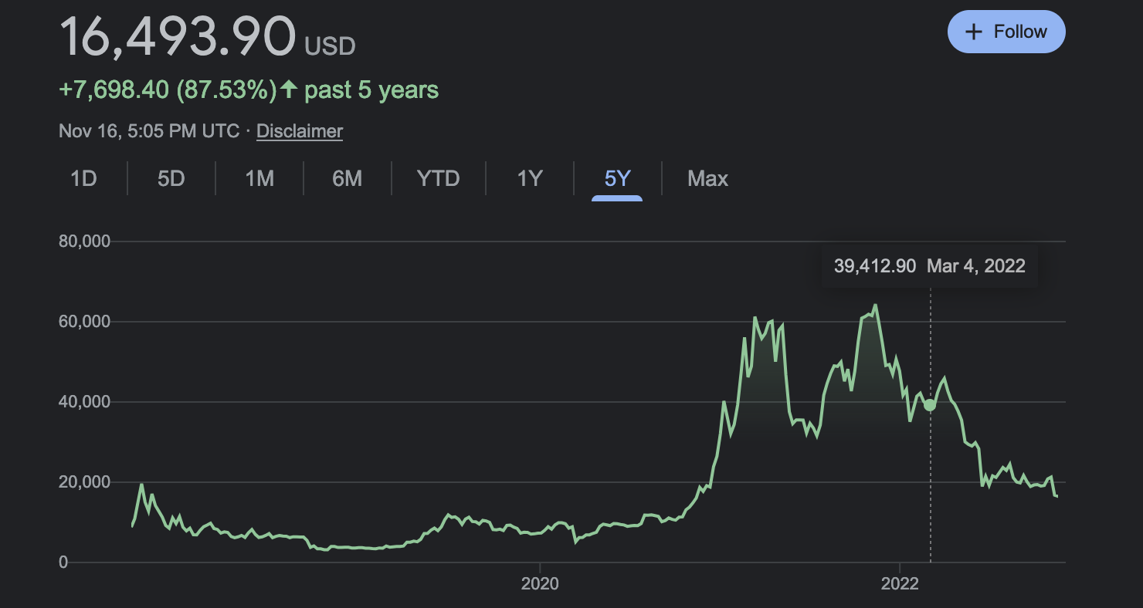
Gravity, VC and Housing
20-22: +42%
Current: -5.5%
Source: PitchBook. Completed, All VC Stage, Global Deals

Slide 15
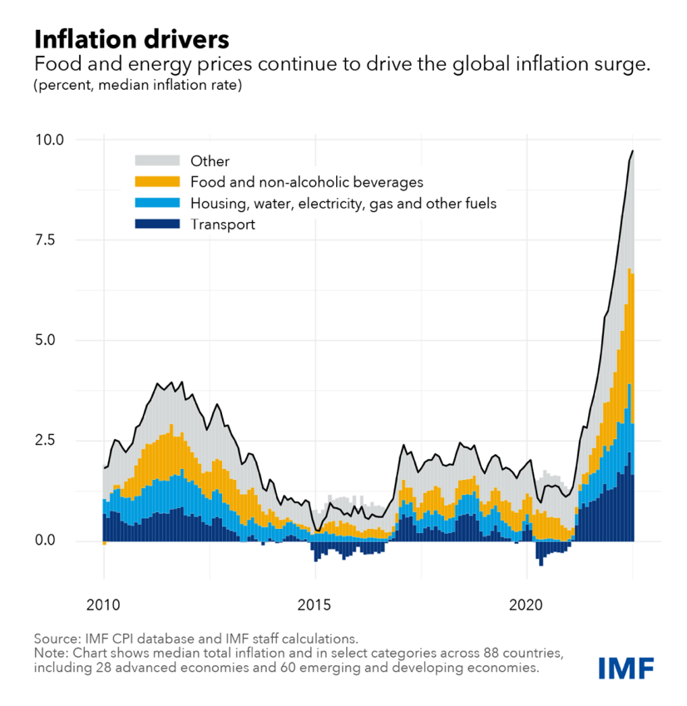
The Inflation Conversation
“Inflation is always and everywhere a monetary phenomenon in the sense that it is and can be produced only by a more rapid increase in the quantity of money than in output.”
Milton Friedman
Supply chain issues
The federal deficit
Greedy corporations and profiteering
Not enough manufacturing jobs in the US
Biden’s bad green energy policies
Putin’s fault!
Saturn is aligned with Jupiter
Kim shouldn’t have dumped Kanye
The Lakers horrible perimeter D

Slide 16
Supply or Demand?

Slide 17
The Fed Response
Changing the pace of price adjustment, not the scale of it…
+40%
-4%

Slide 18
The impact on banking…
 | 2/19/20 | Rate | 7/27/22 | Rate
 | 7/27/22 |  | 2/22/23
Deposits | 4,682,704 | 35.0% | (420,663) | -2.3%
Securities | 1,900,520 | 49.2% | (278,847) | -4.8%
Loans | 1,441,191 | 14.3% | 572,938 | 5.0%

Slide 19
Fed Policy
Conducting the nation's monetary policy by influencing money and credit conditions in the economy in pursuit of full employment and stable prices.
Supervising and regulating banks and other important financial institutions to ensure the safety and soundness of the nation's banking and financial system and to protect the credit rights of consumers.
Error #1: Panic over full employment has negatively impacted price stability
Error #2: Panic over price stability has negatively impacted the banking system

Slide 20
The Lending Response…

Slide 21
Recent Real GDP Growth
Contributions to Real GDP Growth
 | 2019 | 2020 | 2021 | 2022
GDP | 2.30 | -2.80 | 5.90 | 2.10
Final Demand | 2.36 | -1.99 | 6.91 | 1.76
Personal consumption | 1.34 | -2.01 | 5.54 | 1.90
Durable goods | 0.27 | 0.70 | 1.46 | -0.03
Nondurable goods | 0.39 | 0.37 | 1.26 | -0.07
Services | 0.69 | -3.08 | 2.83 | 1.99
Fixed investment | 0.44 | -0.40 | 1.30 | -0.06
Structures | 0.07 | -0.32 | -0.19 | -0.20
Equipment | 0.07 | -0.59 | 0.52 | 0.22
Intellectual property | 0.34 | 0.23 | 0.50 | 0.45
Residential | -0.04 | 0.28 | 0.47 | -0.54
Change in inventories | 0.05 | -0.55 | 0.24 | 0.74
Net exports | -0.11 | -0.26 | -1.25 | -0.40
Exports | 0.06 | -1.54 | 0.64 | 0.81
Imports | -0.17 | 1.28 | -1.89 | -1.20
Government | 0.58 | 0.45 | 0.11 | -0.10
Federal | 0.25 | 0.41 | 0.17 | -0.17
State and local | 0.32 | 0.04 | -0.06 | 0.07

Slide 22
Still Pent-Up Consumer Demand
Dec: 118,000

Slide 23
A shift back to consumer services…
+40%

Slide 24
Travel + Hotels
Region | RevPAR |  | Occ. Rate |  | ADR
 | Q3-22 | 3-Yr % Gr. | Q3-22 | 3-Yr % Dif. | Q3-22 | 3-Yr % Gr.
United States | $95.6 | +15.5% | 67.4% | +2.3% | $141.7 | 11.4%
Inland Empire | $86.8 | +9.9% | 72.1% | -0.2% | $120.5 | 10.3%
Las Vegas | $87.0 | +44.8% | 60.8% | +17.5% | $143.1 | 3.0%
Los Angeles | $134.3 | +5.0% | 75.1% | -5.3% | $178.8 | 12.4%
Orange County | $115.0 | +8.0% | 75.8% | -2.9% | $151.7 | 12.0%
San Diego | $134.8 | +16.2% | 78.4% | +0.7% | $172.1 | 15.2%
San Francisco | $193.8 | +10.9% | 80.7% | -1.5% | $240.0 | 12.9%
Source: CalTravel, LAX

Slide 25
Local Spending
 | 2022 | 3 Yr Gr |  |  | 2022 | 3 Yr Gr
Glendale | $3,247,403 | 13.0% |  | Covina | $711,768 | 20.4%
Santa Clarita | $3,022,439 | 25.9% |  | Monterey Park | $671,253 | 33.3%
Pasadena | $2,594,034 | 13.3% |  | Glendora | $668,362 | 15.0%
Burbank | $2,563,965 | 5.5% |  | Baldwin Park | $519,002 | 24.2%
Industry | $2,322,329 | 7.2% |  | San Dimas | $515,994 | 24.3%
Palmdale | $1,681,802 | 24.9% |  | Claremont | $491,222 | 69.4%
West Covina | $1,514,621 | 33.7% |  | Azusa | $486,739 | 20.8%
El Monte | $1,483,839 | 29.7% |  | San Fernando | $442,585 | 26.1%
Pomona | $1,449,511 | 30.3% |  | South El Monte | $424,863 | 24.2%
Alhambra | $1,207,327 | 9.9% |  | Rosemead | $420,203 | 18.1%
Whittier | $1,146,168 | 72.6% |  | Duarte | $386,600 | 6.7%
Montebello | $877,558 | 9.1% |  | Diamond Bar | $384,161 | 11.3%
Arcadia | $786,250 | 12.2% |  | La Verne | $327,805 | 13.9%
Monrovia | $776,270 | 18.9% |  | Irwindale | $315,992 | 26.4%

Slide 26
Can the consumer survive? Context…

Slide 27
The Income Argument

Slide 28
Income vs Wealth
+$30 Trillion

Slide 29
Business is managing as well…

Slide 30
Business’s real issue…
Job Openings Rate by Sector | Jul-19 | Jul-22
Total private | 4.2 | 7.7
Health care | 2.8 | 9.3
Leisure hospitality | 6.7 | 9.3
Professional | 5.4 | 9.0
Logistics | 3.9 | 8.0
Other services | 3.7 | 7.5
Financial activities | 2.6 | 7.0
Information | 3.9 | 7.0
Retail trade | 4.9 | 6.5
Manufacturing | 2.5 | 6.2
Education | 2.6 | 6.0
Mining and logging | 3.7 | 5.7
Government | 1.5 | 5.2
Wholesale trade | 2.8 | 4.9
Local education | 1.6 | 4.7
Construction | 5.1 | 4.7
Source: VisitCalifornia

Slide 31
The Era of Labor Shortages is Here
Forecast

Slide 32
A 2-edged sword…

Slide 33
Personal Finances
Source: Equifax, American Community Survey

Slide 34
Business Investment
Real Business Investment | 2019 | 2022
 | Q3 | Q3
Private fixed investment | 3437.0 | 3550.5 | 3.3%
Software | 471.3 | 653.5 | 38.7%
Information processing eq | 486.6 | 582.3 | 19.7%
Research and development | 459.5 | 540.3 | 17.6%
Entertainment, literary | 85.0 | 94.8 | 11.5%
Industrial equipment | 248.7 | 258.9 | 4.1%
Manufacturing | 63.3 | 59.8 | -5.5%
Transportation equipment | 270.8 | 249.1 | -8.0%
Commercial and health care | 172.0 | 136.5 | -20.6%
Mining exploration | 132.0 | 100.2 | -24.1%
Power and communication | 123.2 | 79.9 | -35.1%

Slide 35
Filming in Los Angeles
Permitted Shooting Days by Film Type:
Type | 2021 (days) | 2 YR Abs. Chg | Percent Change
 |  |  | 2 YR | 5 YR
Television | 18,560 | 5,051 | 37.4 | 12.7
Other | 10,424 | -3,602 | -25.7 | -21.1
Commercials | 5,319 | 29 | 0.5 | 4.5
Feature Films | 3,406 | -309 | -8.3 | -30.0
Total | 37,709 | 1,169 | 3.2 | -4.8
Source: FilmLA, *Q1 and Q2

Slide 36
Venture Capital – LA County Headquartered Bus.
Company (LA HQ) | Industry Group | Deal Size ($M)
Faraday Future | Automotive | 2,000.0
SpaceX | Aerospace and Defense | 1,901.5
Snap Group | Social/Platform Software | 1,808.6
SpaceX | Aerospace and Defense | 1,725.0
SpaceX | Aerospace and Defense | 1,600.0
Faraday Future | Automotive | 1,250.0
SpaceX | Aerospace and Defense | 1,164.1
Faraday Future | Automotive | 1,080.0
Canoo | Automotive | 1,000.0
Idealab | Other Commercial Services | 1,000.0
Source: PitchBook

Slide 37
Nonresidential Permits
Permit Type | 2022 Permit Value ($M) | 1-Yr Abs. Change
Alterations | 2,248.3 | 1,359.8
Commercial | 1,040.3 | 654.9
Retail | 838.3 | 681.3
Office | 56.3 | -81.1
Hotel | 40.9 | -11.8
Source: CIRB

Slide 38
Regionally? Who is Ahead? Behind?
Current State Job Opening Rate, with change 19-22
Payroll Job Gains 14 to 22
Alaska | 10.1 | 4.1 |  | South Carolina | 7.4 | 2.5 |  | Nebraska | 6.6 | 1.9
Kentucky | 7.9 | 3.4 |  | Iowa | 6.9 | 2.4 |  | Arizona | 7.1 | 1.7
Georgia | 7.9 | 3.1 |  | Oklahoma | 7.2 | 2.4 |  | Wisconsin | 6.7 | 1.7
Tennessee | 7.6 | 2.9 |  | Maine | 7.0 | 2.4 |  | Pennsylvania | 5.9 | 1.6
Illinois | 6.9 | 2.9 |  | Hawaii | 7.1 | 2.4 |  | Florida | 6.2 | 1.6
Massachusetts | 7.2 | 2.8 |  | Alabama | 6.8 | 2.3 |  | Utah | 6.4 | 1.5
Delaware | 7.3 | 2.8 |  | Vermont | 7.4 | 2.3 |  | Indiana | 6.5 | 1.5
Mississippi | 7.3 | 2.7 |  | Michigan | 6.9 | 2.3 |  | Arkansas | 6.7 | 1.5
Montana | 8.3 | 2.7 |  | California | 6.5 | 2.2 |  | North Dakota | 7.0 | 1.5
Louisiana | 7.5 | 2.7 |  | New Hampshire | 6.7 | 2.2 |  | New Jersey | 5.7 | 1.4
Wyoming | 8.4 | 2.7 |  | Rhode Island | 6.9 | 2.2 |  | Kansas | 6.4 | 1.4
Connecticut | 6.5 | 2.7 |  | South Dakota | 7.1 | 2.1 |  | New Mexico | 7.4 | 1.3
Virginia | 7.9 | 2.7 |  | Maryland | 7.0 | 2.1 |  | Missouri | 6.4 | 1.3
Minnesota | 7.1 | 2.6 |  | Colorado | 7.4 | 2.1 |  | Oregon | 6.5 | 1.3
Texas | 7.2 | 2.6 |  | Ohio | 6.8 | 2.1 |  | New York | 5.4 | 1.2
Nevada | 6.8 | 2.6 |  | Idaho | 7.2 | 2.0 |  | Washington | 6.1 | 1.2
West Virginia | 8.3 | 2.6 |  | District of Columbia | 5.9 | 1.9 |  | North Carolina | 7.0 | 1.1
 |  | Payrolls | Gr 14-22 | Gr 19-22
1 | Idaho | 825.4 | 26.1% | 8.2%
2 | Utah | 1676.3 | 26.0% | 7.3%
3 | Florida | 9460.5 | 20.4% | 5.3%
4 | Arizona | 3088.7 | 20.0% | 4.6%
5 | Nevada | 1462.0 | 19.7% | 3.0%
6 | Texas | 13539.1 | 16.3% | 5.3%
7 | Colorado | 2874.2 | 16.2% | 2.6%
8 | North Carolina | 4804.3 | 15.8% | 4.6%
9 | Georgia | 4821.8 | 15.8% | 4.2%
10 | Washington | 3522.5 | 14.8% | 1.3%
11 | Tennessee | 3247.0 | 14.6% | 3.8%
12 | South Carolina | 2238.7 | 14.5% | 1.9%
13 | Oregon | 1974.7 | 14.0% | 0.8%
14 | California | 17650.9 | 13.0% | 1.1%
15 | Montana | 506.0 | 11.2% | 4.1%

Slide 39
The Real California vs Texas Story

Slide 40
The State Employment Situation
 | Payroll |  |  | UN Rate |  |  | Labor Force
Total Nonfarm | Nov-22 |  |  | Nov-22 |  |  | Nov-22
Stockton | 266.8 | 6.7% |  | 6.3 | 0.0 |  | 337.0 | 2.2%
Inland Empire | 1677.9 | 6.3% |  | 4.9 | 0.6 |  | 2168.5 | 3.8%
Visalia | 136.1 | 4.9% |  | 9.8 | -0.5 |  | 206.5 | 2.0%
Sacramento | 1057.7 | 2.5% |  | 4.3 | 0.4 |  | 1112.7 | 0.9%
Fresno | 375.7 | 2.1% |  | 7.5 | -0.1 |  | 451.9 | -0.4%
San Jose | 1180.1 | 1.8% |  | 2.9 | 0.0 |  | 1083.6 | -0.2%
Santa Barbara | 198.8 | 1.7% |  | 3.8 | 0.0 |  | 223.7 | 0.1%
Bakersfield | 279.9 | 1.2% |  | 8.2 | 0.1 |  | 388.8 | 0.4%
San Diego | 1527.2 | 0.8% |  | 4.1 | 0.5 |  | 1568.0 | -0.7%
Modesto | 183.4 | 0.2% |  | 6.4 | 0.2 |  | 238.9 | -2.1%
Los Angeles | 4594.7 | 0.1% |  | 4.9 | 0.5 |  | 4955.9 | -4.7%
Orange | 1680.4 | 0.0% |  | 3.6 | 0.4 |  | 1584.1 | -1.6%
Ventura | 312.0 | -0.5% |  | 4.2 | 0.2 |  | 411.5 | -2.3%
San Francisco | 1190.5 | -0.6% |  | 2.7 | 0.3 |  | 1023.4 | -1.6%
Oakland | 1185.3 | -0.9% |  | 3.9 | 0.6 |  | 1373.4 | -2.0%
Santa Rosa | 206.0 | -2.0% |  | 3.5 | 0.5 |  | 247.1 | -3.9%
Vallejo | 137.2 | -3.0% |  | 5.0 | 1.0 |  | 199.3 | -3.7%
Salinas | 140.9 | -3.1% |  | 7.0 | 0.6 |  | 211.9 | -4.1%

Slide 41
SoCal Labor Market
Source: California EDD

Slide 42
Labor Supply Constraints
Solutions
Extensive: Increasing labor force through immigration (SR) or birthrates (LR)
Intensive: Raising participation rates among the existing population
Productivity enhancements: capital investments / skill training
Forecast
Source: REIS

Slide 43
The Housing Market

Slide 44
A Rate Driven Sticker Shock
Case Shiller HPA
July 20 – July 22
Tampa | 64.0% |  | Los Angeles | 37.9%
Phoenix | 62.0% |  | SF | 35.1%
Miami | 61.4% |  | New York | 34.9%
Dallas | 54.2% |  | Boston | 34.6%
Charlotte | 49.5% |  | Portland | 33.6%
LV | 49.2% |  | Cleveland | 30.9%
SD | 49.1% |  | Detroit | 29.4%
Atlanta | 45.8% |  | Chicago | 27.4%
Seattle | 43.9% |  | DC | 26.0%
Denver | 40.3% |  | Minneapolis | 24.6%

Slide 45
Market Collapse? Not a chance…

Slide 46
Collapse of Filtering, not Fundamentals
Overall Housing Vacancy
 | Northeast | Midwest | South | West
Vacant Year Round 2022 | 7.6% | 7.4% | 9.6% | 6.6%
For Sale / Rent | 2.0% | 2.4% | 2.7% | 2.0%
Vacant Year Round 2012 | 8.9% | 9.9% | 12.6% | 9.0%
For Sale / Rent | 3.3% | 4.0% | 4.7% | 3.5%
Vacant Year Round 2008 | 8.6% | 9.8% | 12.3% | 8.4%
For Sale / Rent | 3.6% | 4.9% | 5.3% | 3.6%

Slide 47
Market Driver: Housing Demand

Slide 48
Apartments
Source: REIS

Slide 49
Supply, Not Affordability
Share Households > 35% Housing Cost to Income
 | 2018 | 2021 |  | 2018 | 2021
California | 29.4% | 29.6% |  | 45.4% | 46.4%
Los Angeles | 34.3% | 35.2% |  | 47.8% | 49.6%
Riverside | 31.9% | 31.1% |  | 51.6% | 48.8%
San Bernardino | 27.7% | 28.6% |  | 48.2% | 46.8%
Sacramento | 24.4% | 24.2% |  | 45.8% | 46.0%
Fresno | 24.5% | 25.5% |  | 46.9% | 44.9%
Santa Clara | 25.5% | 25.3% |  | 36.4% | 34.7%
*YTD Q3
Source: CIRB

Slide 50
A bumpy path ahead…
Expansion to Continue
Wealth and income will drive consumer spending
Business spending to offset labor shortages
Asset values to fall, liquidity drying up
Inflation will continue to be hot
Rates should settle down given bond market liquidity
Underlying asset quality to remain strong
Los Angeles
Everything is up, except for population and labor force
Core sectors performing well
Incomes up sharply
Real estate losing liquidity, suffering a lack of sellers
Demand for housing to remain high
Region needs focus on expanding housing, not rescuing residents
Potential Scenarios
What will the Fed do? Raise it ‘til they break it?
Wild card: National / local fiscal situation in short and long run
Global situation: China RE / Russian aggression
Brittle economy—subject to shocks
Gap between economic reality and political narratives still dangerously wide

Slide 51
Los Angeles County Revenue Forecasts

Slide 52
Economic Outlooks
Revenue Forecasts
Cost Projections
Regional Development
Housing Studies
Impact Reports
CEDS Analysis
Policy Studies
Industry Studies
Labor Markets

